Slide 1

NATIONAL INSTITUTE OF TECHNOLOGY MANIPUR COMPUTER SCIENCE AND ENGINEERING ALGORITHMIC TRADING USING MACHINE LEARNING ALGORITHMS
Project supervisor:
mr. sanabam binesHwOr SINGH
Group members:
Sweta Chaudhary (19103053)
Mayank raj (19103029)

Slide 2
OUTLINE OF THE PROJECT:- A MODEL IS DEVELOPED USING LOGIC,PATTERN RECOGNITION IN HISTORICAL DATA AND IT IS USED TO PREDICT POSITION SIZE AND PRICE OF STOCKS IN THE FUTURE. THIS PROJECT IS MADE USING PYTHON,MACHINE LEARNING CONCEPTS, LIBRARIES LIKE NUMPY, PANDAS, SCIKIT.
AIM :-
TO MAKE AN ALGORITHMIC TRADING SYSTEM WHICH CAN PREDICT POSITION SIZE WITH ADEQUATE EFFICIENCY.

Slide 3
ABSTRACT:-
Computer and Machine Learning advancements have offered new prospects for enhancing trading processes. Algorithmic trading combines computer programming and financial markets to execute trades at precise moments. It attempts to strip emotions out of trades, ensures the most efficient execution of a trade, places orders instantaneously, and lowers trading fees. During the research, we analyzed various trading strategies according to market nature and their yield. This helped in better decision-making when it comes to financial stability. In previous research works, the dynamic nature of the market and changes due to it was not taken into account, but we have rigorously analyzed it and noted down the subtle changes that it accounts for. In our research, we collected data from different exchanges through customized APIs, and then for the modeling of algorithms, we used Machine Learning Algorithms where we implemented the Decision Tree using different trading strategies giving them proper weightage. For Back Testing we tested our algorithm by providing different shares and their real-time graphs. Our statistical analysis suggested we got more favorable outcomes than previous works on the same matter and it gave a new perspective to think about when it comes to Algo trading. The broader Implication of our research is that one can rely on the deductions of the algorithm and can have a better understanding of the nature of the market and it reduces the risk of loss. Trading methods that use algorithms adhere to predetermined criteria and are based on timing, price, quantity, or any mathematical model. In addition to providing the trader with profit opportunities, an algorithmic trading increase market liquidity and standardizes trading by removing human emotions from the equation.

Slide 4
Motivation:-
Financial knowledge is something very much neglected but should be given importance it deserves.
The main motivation behind choosing this topic is to highlight the importance of trading in one’s life while still young.
Being software engineers gives us high advantage as one can easily combine knowledge of trading with coding to develop a software which can ease our lives . As the algorithm attempts to strip emotions out of trades, ensures the most efficient execution of a trade, places orders instantaneously, and lowers trading fees.

Slide 5
INTRODUCTION:-
Algorithmic trading (also called automated trading, black-box trading, or algo-trading) uses a computer program that follows a defined set of instructions (an algorithm) to place a trade. The trade, in theory, can generate profits at a speed and frequency that is impossible for a human trader.
Algorithmic trading combines computer programming and financial markets to execute trades at precise moments.
Algorithmic trading attempts to strip emotions out of trades, ensures the most efficient execution of a trade, places orders instantaneously and may lower trading fees.
Common trading strategies include trend-following strategies, arbitrage opportunities, and index fund rebalancing.
Algorithmic trading is also executed based on trading volume (volume-weighted average price) or the passage of time (time-weighted average price).

Slide 6
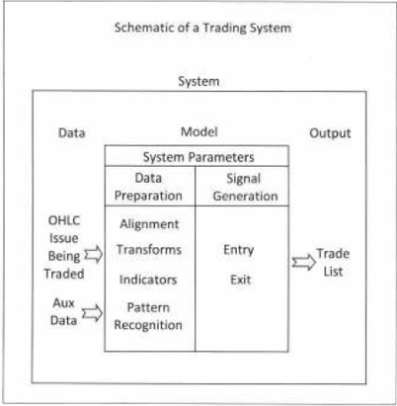
Trading system

Slide 7
INDICATORS IN TRADING- EXPONENTIAL AND SIMPLE MOVING AVERAGE- It is generally a trend based indicator that has two variants- exponential moving average(EMA) and simple moving average(SMA). SMA gives equal weight to the earlier values in a certain rolling window while EMA gives more weight to the recent events. BOLLINGER BANDS- It can help you decide the upper bound and lower bound of volatility present in the market in a given period of time. ADX- Average moving direction index is used to measure the overall strength of a trend in the market for a given time frame.

Slide 8
REGRESSION- The regression line can be used to find the slope of the trend. We can easily fit a y=mx+c equation for a certain duration using least squares fit. The slope of line tells us about the strength as well as the direction of the trend. RSI (RELATIVE STRENGTH INDEX)- It is a momentum indicator used in technical analysis that measures the magnitude of recent price changes to find overbrought or oversold scenarios in stock, currency or commodity prices.

Slide 9
SURVEY 1.) In 2021 survey of long-only funds the average score of respondents is 5.81 – an increase from both the 2020 score (5.71) and the 2019 score (5.74). In 2021, the most impactful features of algorithms are ease of use, customer support and services, dark pool access, execution consistency and increased trader productivity . 2.) Following from high scores of 5.96 and 5.92 respectively in the 2020 survey, support services and ease of use both scored 6.01 in 2021’s survey. It is interesting to see ease of use increase its score year-on-year over the past four years, underlining the importance of usable and streamlined technology in the modern trading environment. 3.) Two categories in this year’s survey recorded the joint highest year-on-year increase in their score, anonymity and algo monitoring. Both categories received an increase of 0.17, putting anonymity at 5.89 and algo monitoring at 5.72. Increase in trader productivity marks the second highest jump in score, having increased by 0.16 from 5.80 to 5.97. This jump shows the growing role that algos play in boosting the performance of traders. While all scores in 2021 were up from 2020. 4.) We are going to combine many popular strategy like strategies are arbitrage, index fund rebalancing, mean reversion, and market timing. Other strategies are scalping, transaction cost reduction, and pairs trading in our algo trading model. So if any one of the strategy failed to work according to the given conditions/criteria the other strategy will take its place for further process.

Slide 10
WHY IS THERE NEED FOR A NEW ONE? Because last model were only using only one of strategy which may result in more chances of losing but in our model we will merge numbers of strategies to make our trading having more chances of success so if one of the strategy is not working for given conditions other strategy will be automatically implemented. HOW WILL IT BE DIFFERENT FROM OTHERS?(ADVANTAGE OF PROPOSED METHOD) We will try to develop our own Rules And Strategy and mix it with few famous efficient strategies to get maximum efficiency out of the algorithm. Then finally for the training part we will apply different ML algorithms and see which works the best.

Slide 11
CHALLENGES- 1) The biggest challenge in the trading process is planning the trade and trading the plan. Failure to follow all the rules is likely to negatively alter any chance for a trader, even if the trading plan can be profitable . Although losses are part of trading, human traders may get discouraged after incurring two or more consecutive losses and fail to move to the next trade. 2) Also, there can be a difference between the trades generated by the trading strategy and the actual results from the automated trading systems. Automated trading systems should be monitored at all times to prevent mechanical failures. 3) Internet connectivity issues, power losses, and computer crashes can result in errant orders, duplicate orders, and even missing orders that might not be sent to the market.

Slide 12
PROPOSED ALGORITHM- 1)Data collection 2)Making rules and making decision tree 3)Recognising pattern in the historical data 4)Training the system on past data using different ML algorithms (decision tree, random forest classifier) 5)Testing , validating

Slide 13
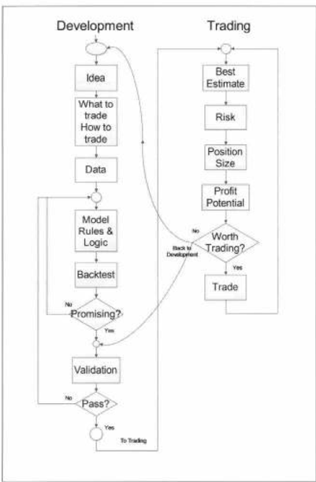
Components of trading system- 1.) Development 2.) trading

Slide 14
REQUIREMENT ANALYSIS (SOFTWARE REQUIREMENT)-
Data Collection –
API SANDBOX –
API sandbox is a feature for simulating and testing Application Programming Interface (API). For developers, those activities are pivotal. Before integrating API in the production environment, they must be aware of errors that could occur in the integration process.
ii) IEX CLOUD API -
IEX Cloud is a platform that makes financial data and services accessible to everyone. The IEX Cloud API is based on REST, has resource-oriented URLs, returns JSON-encoded responses, and returns standard HTTP response codes.

Slide 15
PROCEDURE
2. Developing Hypothesis for Strategy
i) S&P 500 Equal Weight Index (EWI) –
This is an equal-weight version of the popular S&P 500 Index . Although both indexes are composed of the same stocks, the different weighting schemes result in two indexes with different properties and different benefits for investors.
II)Quantitative Momentum Investing Strategy –
It is an investment strategy which selects for investment the stocks whose price appreciated the most during a period.

Slide 16
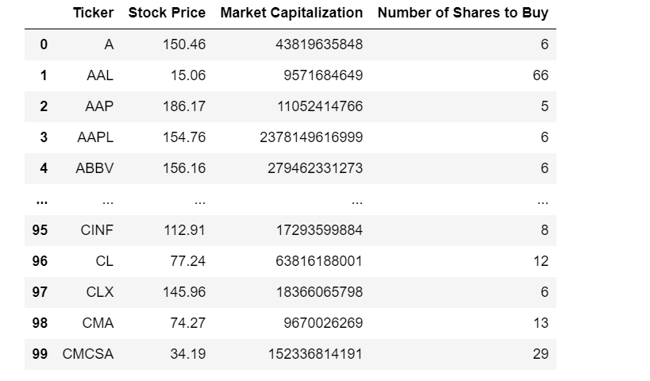
S&P 500 Equal Weight Index (EWI) This is an equal-weight version of the popular S&P 500 Index. Although both indexes are composed of the same stocks, the different weighting schemes result in two indexes with different properties and different benefits for investors. This section aims to create a Python script that will accept the value of your portfolio and tell you how many shares of each S&P 500 constituent you should purchase to get an equal-weight version of the index fund.

Slide 17
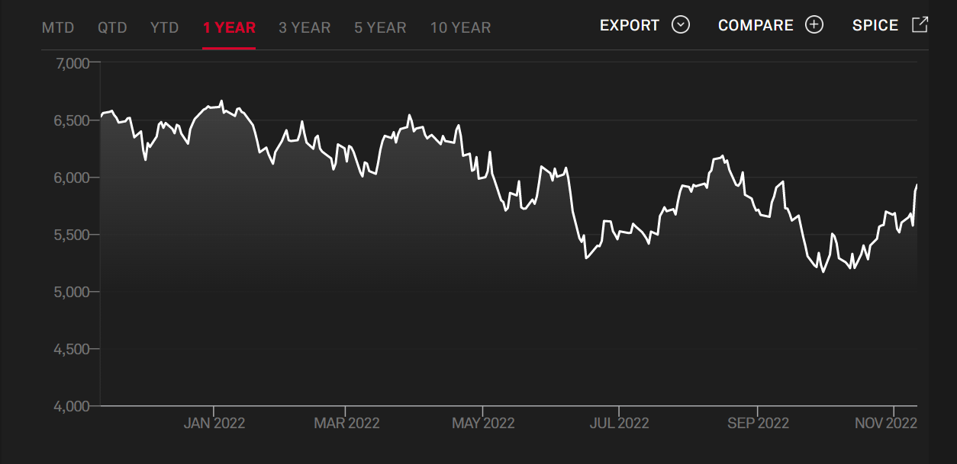
S&P 500 Equal Weight Index (EWI) –

Slide 18
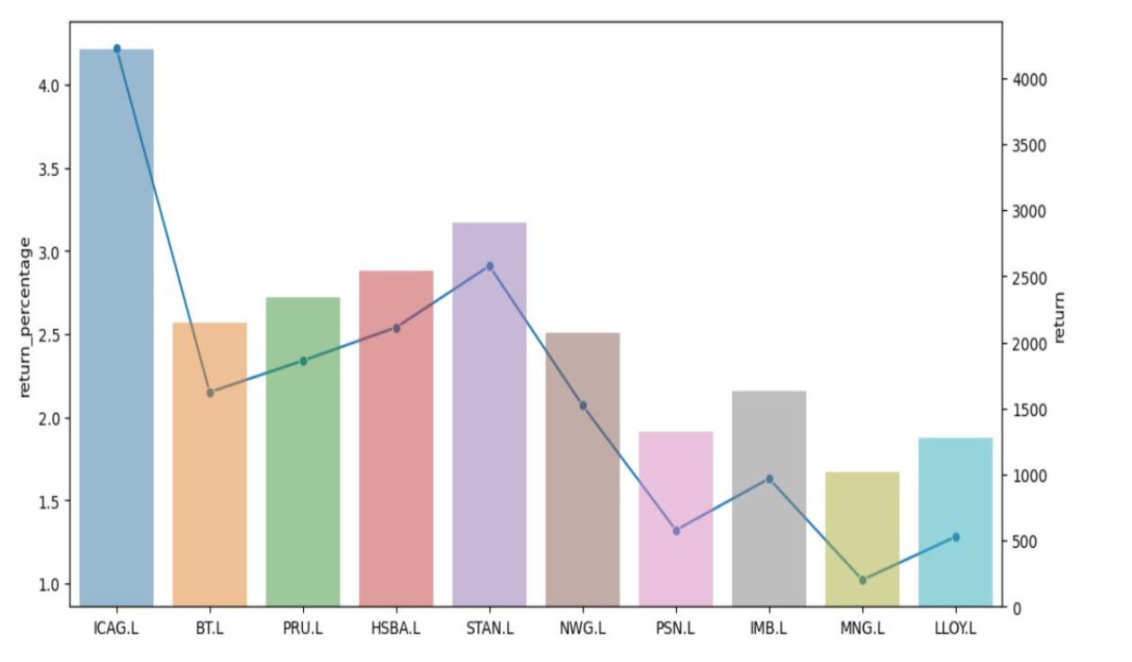
Quantitative Momentum Investing Strategy
It is an investment strategy that selects for investment the stocks whose price appreciated the most during a period. The goal is to work with volatility by finding buying opportunities in short-term uptrends and then selling when the securities start to lose momentum. The investor takes the cash, looks for the next short-term uptrend, or buying opportunity, and repeats the process.

Slide 19
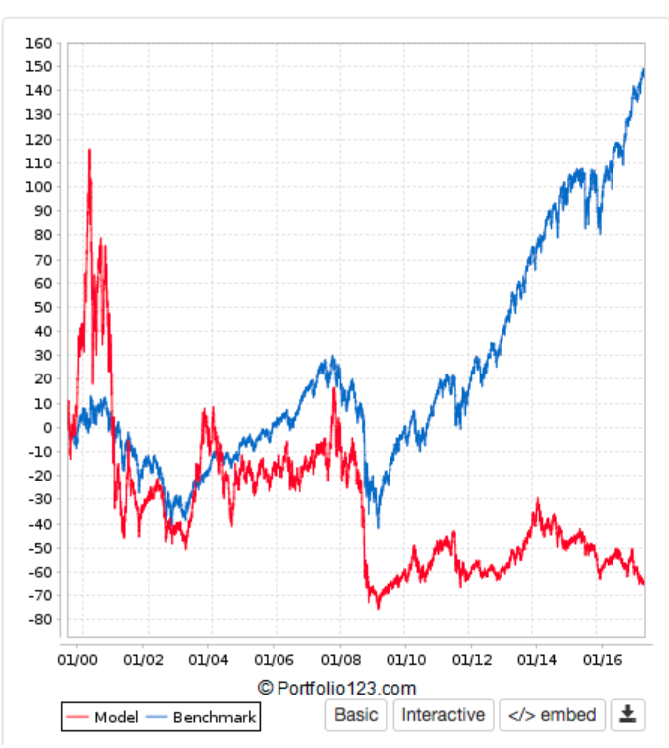
Quantitative Momentum Investing Strategy

Slide 20
PROCEDURE
2. Developing Hypothesis for Strategy-
iii) Quantitative Value Investing Strategy-
It is an investing strategy that selects for investment the highest-quality cheapest stocks using state-of-the-art computer algorithms. Implementation of Quantitative Value has generated returns with relatively low volatility, and low asset turnover.
iv) Implementation of various Decision Trees
depending upon Nature of Charts like double bottom double top , moving averages , reversal trading , Range trading , breakout trading.

Slide 21
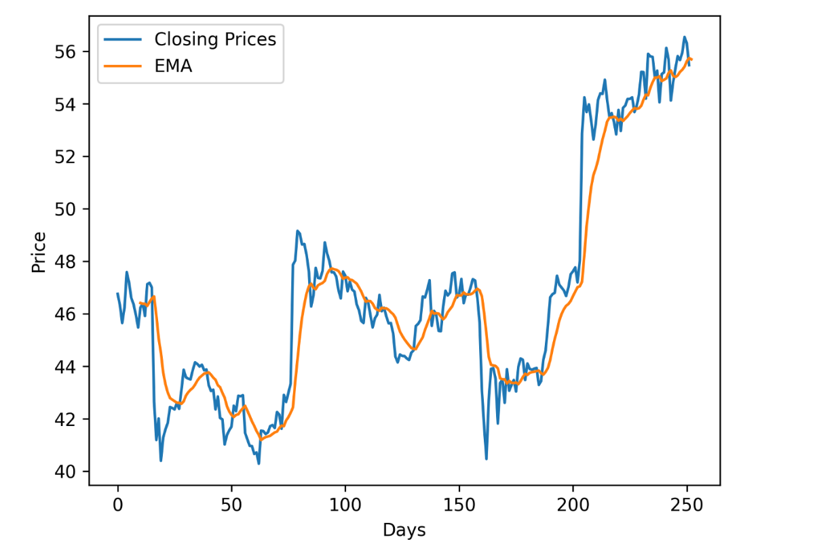
Exponential Moving Average (EMA)
An exponential moving average (EMA) is a type of moving average (MA) that places a greater weight and significance on the most recent data points. The exponential moving average is also referred to as the exponentially weighted moving average. An exponentially weighted moving average reacts more significantly to recent price changes than a simple moving average simple moving average (SMA), which applies an equal weight to all observations in the period.

Slide 22
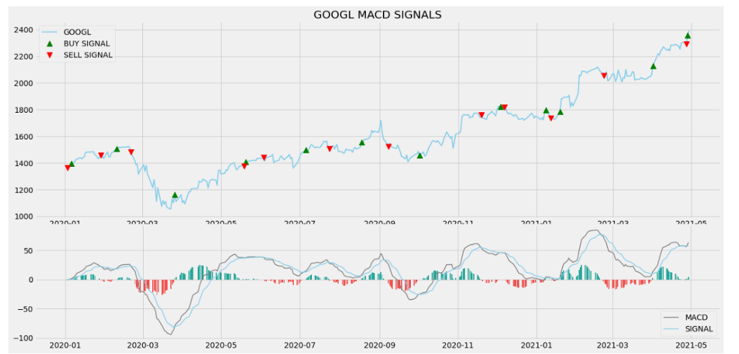
Moving Average Convergence-Divergence (MACD)
The moving average convergence/divergence (MACD, or MAC-D) line is calculated by subtracting the 26-period exponential moving average (EMA) from the 12-period EMA. The signal line is a nine-period EMA of the MACD line. MACD is best used with daily periods, where the norm is the traditional setting of 26/12/9 days. MACD triggers technical signals when the MACD line crosses above the signal line (to buy) or falls below it (to sell).

Slide 23
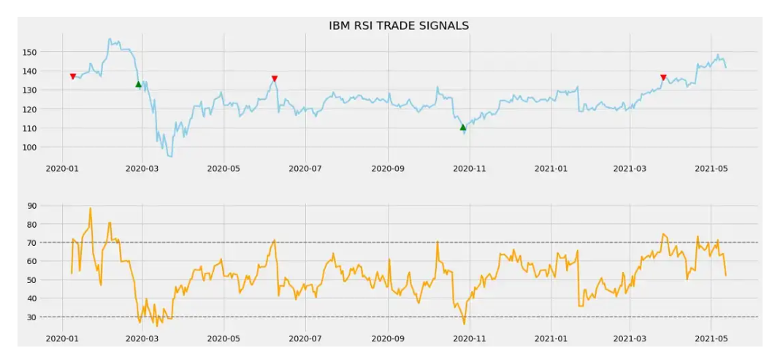
The Relative Strength Index
The relative strength index (RSI) is a momentum indicator used in technical analysis. RSI measures the speed and magnitude of a security's recent price changes to evaluate overvalued or undervalued conditions in the price of that security.
The RSI can do more than point to overbought and oversold securities. It can also indicate securities that may be primed for a trend reversal or corrective pullback in price. It can signal when to buy and sell. Traditionally, an RSI reading of 70 or above indicates an overbought situation. A reading of 30 or below indicates an oversold condition.

Slide 24
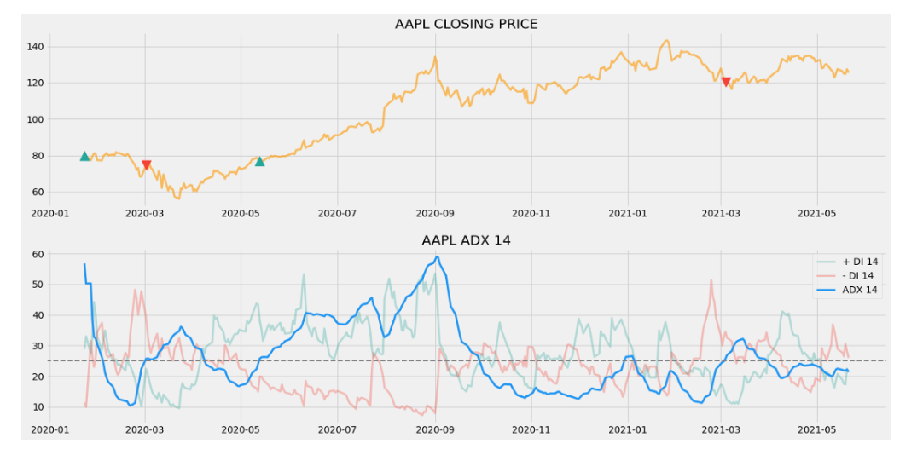
AVERAGE DIRECTIONAL INDEX
Average Directional Index (ADX): works together with a Minus Directional Indicator (-DI) and a Plus Directional Indicator (+DI). The directional movement indicators are used to detect stock trends, typically used to determine entry and exit points. The ADX is derived from the smoothed averages between +DI and –DI. It measures the strength of the trend over time. We can determine the movement’s direction and strength using all three indicators together. The value of ADX ranges between 0 and 100. A reading below 20 indicates trend weakness; all readings above 40 are considered vital.

Slide 25
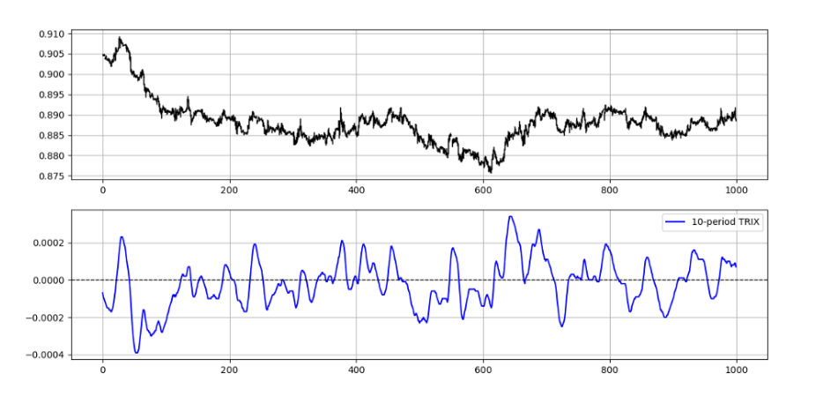
Triple Exponential Average (TRIX)
The triple exponential average (TRIX) is a momentum indicator used by technical traders that shows the percentage change in a moving average that has been smoothed exponentially three times. The triple smoothing of moving averages is designed to filter out price movements that are considered insignificant or unimportant. TRIX is also implemented by technical traders to produce signals similar to the moving average convergence divergence (MACD).

Slide 26
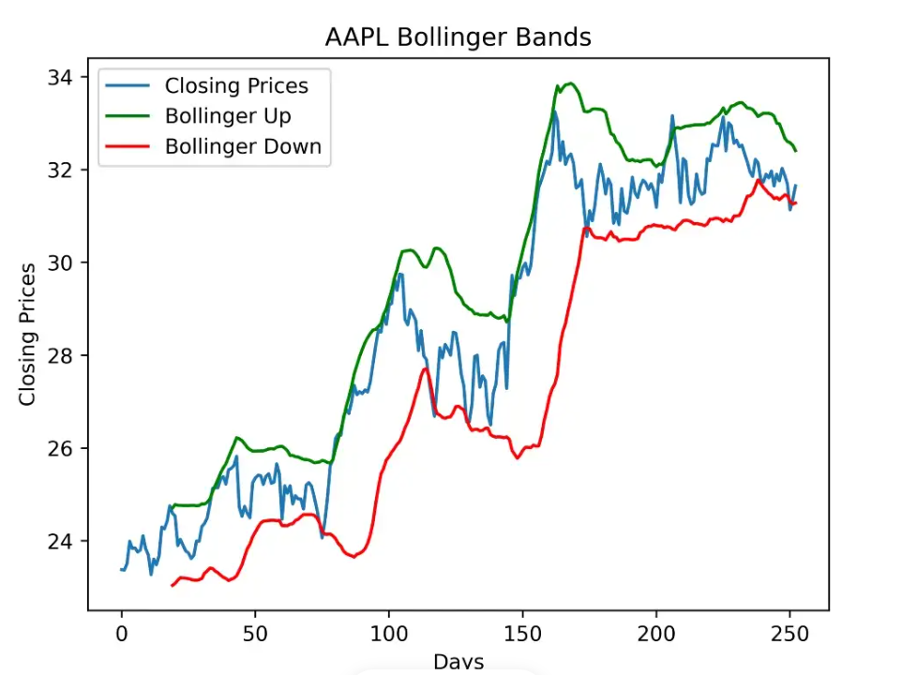
BOLLINGER BANDS
A Bollinger Band is a technical analysis tool defined by a set of
trendlines plotted two standard deviations (positively and negatively)
away from a simple moving average (SMA) of a security's price, but
which can be adjusted to user preferences.

Slide 27
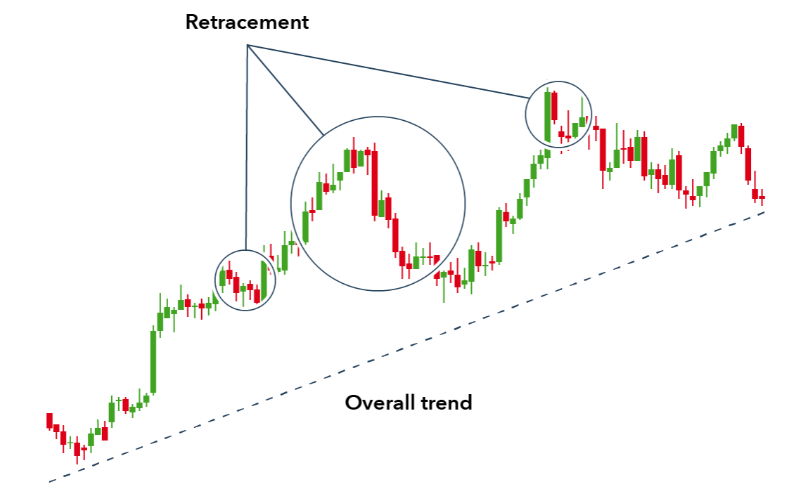
Trend Trading

Slide 28
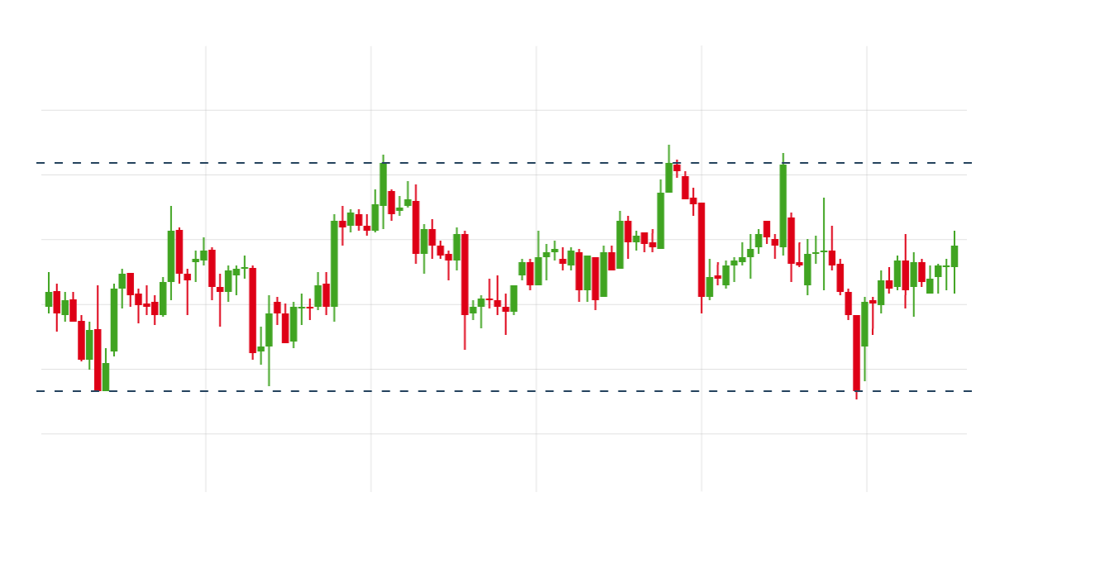
Range Trading

Slide 29
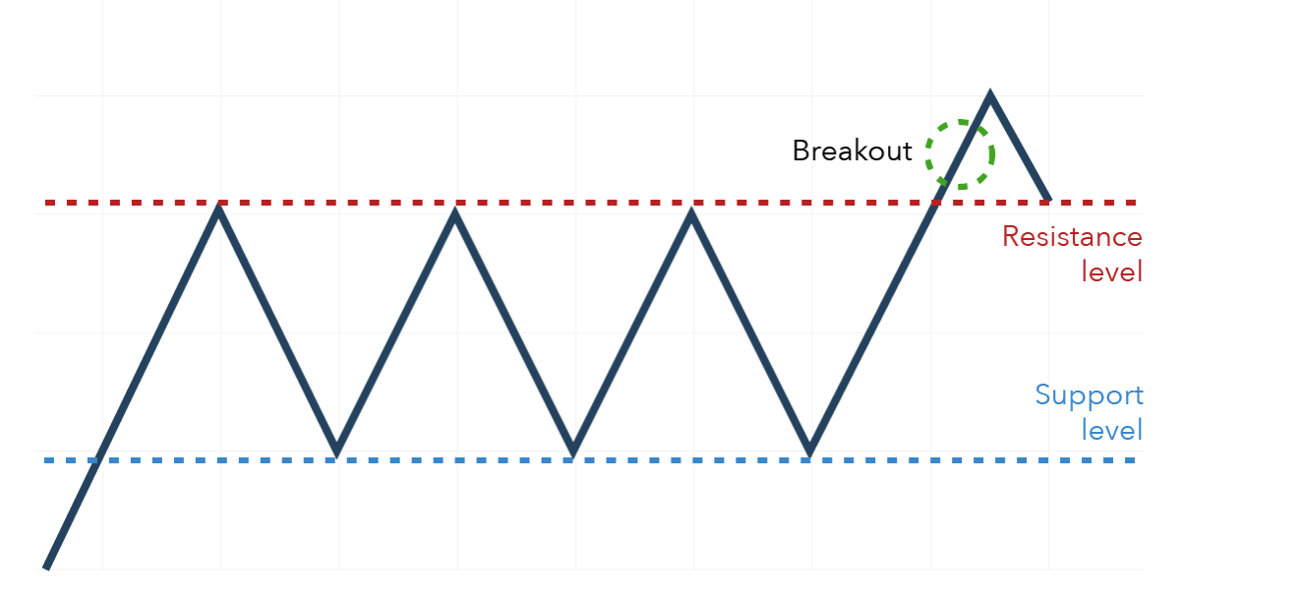
Breakout Trading

Slide 30
PROCEDURE (SOFTWARE REQUIREMENT)-
3. Data Refining
I) Numpy
NumPy is the fundamental package for scientific computing in Python. It is a Python library that provides a multidimensional array object, various derived objects .
II) Pandas
Pandas is a fast, powerful, flexible and easy to use open source data analysis and manipulation tool, built on top of the Python programming language.

Slide 31
PROCEDURE
4. Backtesting the strategy
IBPy –
IBPy is an unaffiliated third party python wrapper for Interactive Brokers trader Workstation API. Before IB started providing their official API library for python, this was the only way to connect to TWS for algorithms written in python.

Slide 32
PROCEDURE
5. Data Visualization –
TradingView –
TradingView is a visualization tool with a vibrant open-source community. It’s entirely web-based, and allows users to visualize data, whether the data is the result of paper trading or algorithmic back-testing. Like Quantopian, TradingView allows users to share their results and visualizations with others in the community, and receive feedback.
6. Implementing the strategy in production –
Upstox –
Online stock trading is buying and selling stocks on an online platform. Upstox provides real-time reports on gains and losses. one can take advantage of industry insights, benchmark comparison reports, and suggestions to improve online stock trading practices.

Slide 33
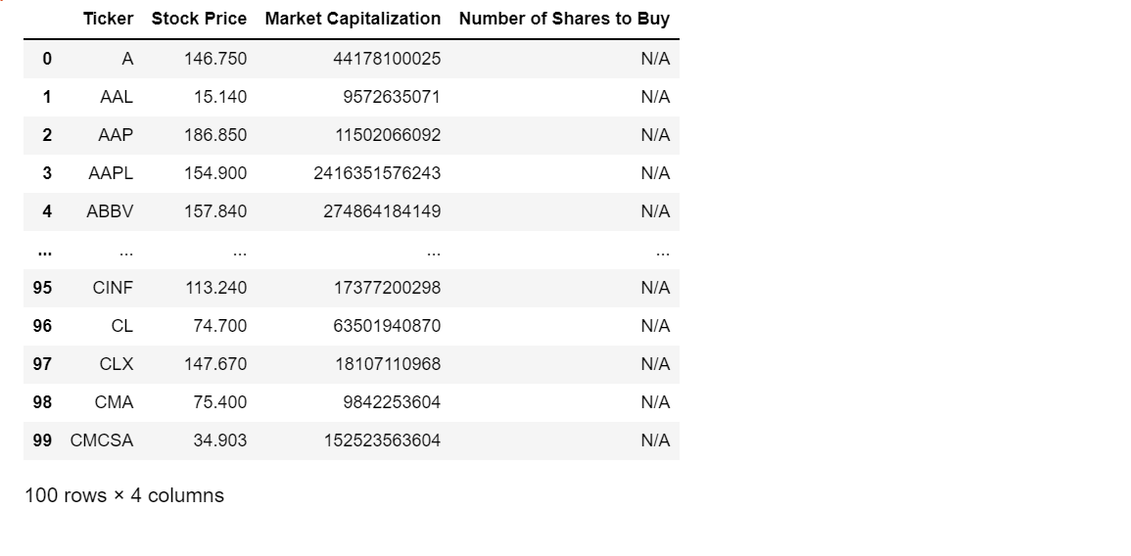
INPUT

Slide 34
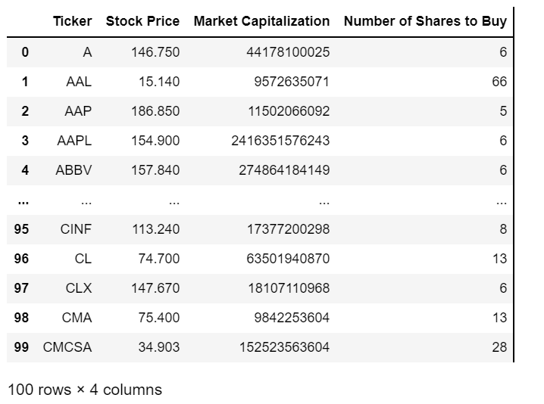
OUTPUT

Slide 35
CONCLUSION
1.Algorithmic trading brings together computer software, and financial markets to open and close trades based on programmed code. Investors and traders can set when they want trades opened or closed.
2.They can also leverage computing power to perform high-frequency trading. With a variety of strategies traders can use, algorithmic trading is prevalent in financial markets today. In order to generate profits at a speed and frequency that is impossible for a human trader. Any strategy for algorithmic trading requires an identified opportunity, which is profitable in terms of improved earnings or cost reduction.
3.The algorithmic trading strategies follow defined sets of rules, and are based on timing, price, quantity or any mathematical model. Apart from profit opportunities for the trader, algorithmic-trading makes markets more liquid and makes trading more systematic by ruling out emotional human impacts on trading activities

Slide 36
REFERENCES-
Wikipedia
www.Investopedia.com
Book on Quantitative technical Analysis (by Howard B. Bandy)
Papers-
A SURVEY ON COMPUTER AUTOMATED TRADING IN INDIAN STOCK MARKETS(ACADEMIA)BY K Sudhakar, S Naganjaneyulu, Y Rama Mohan
Automated Trading System Statistical and Machine Learning methods and hardware implementation: a survey by Boming Huang, Yuxian Huan, Li Da Xu
Machine Learning Techniques For Stock Prediction By Vatsal H shah
Algo-Trading using statistical Learning And Optimizing Sharpe Ratio And DrawdownBy Neeraj Kasheety,Hanumanula Sravya, C Amarnath Reddy,Jaypal Medida

Slide 37
THE END

